Slide 1
IETF 124 Public Side Meeting
Internet of Agents @ Enterprise (IoA@Enterprise)
IETF124 Montreal, Nov 06, 18:30-19:30 AM, P6-7
Toerless Eckert, Futurewei USA (tte@cs.fau.de)
Ran Pang pangran@chinaunicom.cn

Slide 2
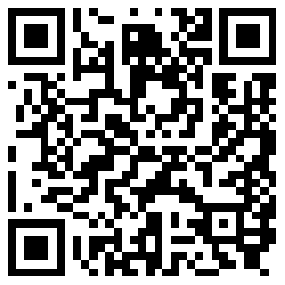
Note Well
By participating in the IETF you agree to follow IETF processes and policies. This Note Well is a reminder
of some of those policies. For a linked version of this text, please visit www.ietf.org/note-well or use the QR code below.
IETF participants are expected to behave in a professional manner and extend respect and courtesy to their colleagues at all times (see RFC 7154: IETF Guidelines for Conduct and IETF Anti-Harassment Policy). If you have any concerns about behavior, please contact the Ombudsteam who have a duty of confidentiality and extensive powers to act, as set out in RFC 7776: IETF Anti-Harassment Procedures.
If you are aware that any IETF contribution (as defined in RFC 5378: Rights Contributors Provide to the IETF Trust) is covered by patents or patent applications that are owned or controlled by you, your employer or your sponsor, you must disclose that fact, or not participate in the discussion
(see RFC 8179: Intellectual Property Rights in IETF Technology).
For detailed process information consult RFC 2026: Internet Standards Process and
RFC 2418: IETF Working Group Guidelines and Procedures and updates to those.
The IETF routinely makes public written, audio, video, and photographic records
of IETF activities, including your personal information as set out in the IETF Privacy Statement.
For advice, please talk to Working Group chairs or Area Directors.
Notes:
The IETF Note Well should be shown at the start of every IETF working session. The guidance below is adapted from IETF legal counsel presentation during IETF 120
DO
Do make sure people have enough time to read through the slide before you move on,
Do give a high-level summary of what’s covered in the Note Well: “IETF policies on conduct, privacy and IPR.”,
Do encourage people to read through all the linked policies & documents in detail before participating or contributing,
Do explain where people can direct questions or concerns (IETF Executive Director or Ombudsteam).
DON'T
Don’t dismiss the importance or relevance of any of the information on the Note Well.
Don’t interpret the meaning or get into the substance of any of the topics or content of the policies.
Don’t communicate that the Note Well conveys all the information participants need to know.
Don’t address questions or concerns in the meeting itself.

Slide 3
Introduction
Public Side Meeting of IETF124 rules: https://www.ietf.org/meeting/side-meetings/
You need to be registered for IETF124 to participate
Note Well of IETF applies to these side meetings as well
Get together of IETF participants interested in Enterprise topics
Mailing list (also to continue discuss of todays topics): enterprise@ietf.org
Agenda, Notes page
  https://notes.ietf.org/notes-ietf-124-public-side-meeting-ioa@enterprise
  Linked from the Trello Schedule Board
  Feel free to add yourself to the Participants list on that notes page
  No mandate for participant collection in IETF side meetings!
  Github for slides (hopefully later also recording):
  https://github.com/qzhgao/Enterprise-Network/tree/main/ietf124-IoA@Enterprise
We would like to record the session!

Slide 4
Agenda
1. Agents Networking Scenarios and Requirements in Enterprise Networks,
  by China Unicom (onsite)
2. Agentic Digital Banking: Scenarios & Solution Architecture
  by UnionPay (remote)
3. Use Cases of Agent Networking for Network Operation and Management
  by Huawei (remote)
4. AI Agent Security Requirements
  by Huawei (onsite)
4. Open discussion & Wrap-up

Slide 5
Open Discussion

